Slide 1
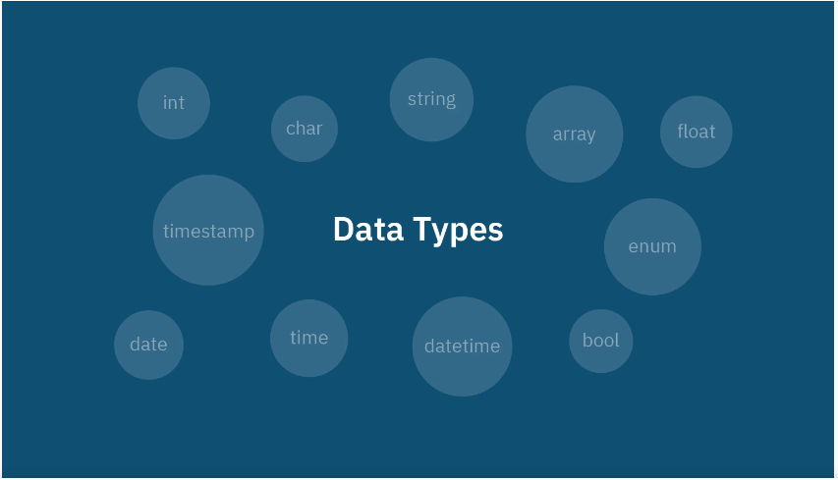


Slide 2
Data types
-SQL developer must decide types of data(stored inside each column) when creating table
-Each column in database require (name, data types)

Slide 3
Data types in SQL 1.Numeric data types 2.Date and Time data types 3.String data types 4.Binary data types

Slide 4
1.Numeric data types
INT
-whole numbers between -2,147,483,648 and 2,147,483,647
BIT
-Integer that can be 0, 1, or null
BIGINT
- whole numbers between -9,223,372,036,854,775,808 and 9,223,372,036,854,775,807
SMALLINT
- whole numbers between -32,768 and 32,767

Slide 5
DECIMAL(p , s) -IF the value needs to be exact, choose DECIMAL data type -fixed-point numeric data type that stores exact values with a specified precision and scale. -For example, a decimal(10,2) can store values with up to 10 digits, 2 of which can be to the right of the decimal point. -up to 131072 digits before the decimal point, up to 16383 digits after the decimal point Float -to store single-precision floating-point numbers -4 bytes of storage -approximately 7 digits. Double -is used to store double-precision floating-point numbers - 8 bytes of storage - approximately 15-16 digits.
Notes:
Single-precision(32 bits =1 bit for the sign, 8 bits for the exponent, and 23 bits for the mantissa)
Double-precision(64 bits=1 bit for the sign,11 bits for the exponent, and 52bits for the mantissa)

Slide 6
2.Date and Time data types
DATE
- (YYYY-MM-DD)
TIME
-(hh:mm:ss)
DATETIME
- (YYYY-MM-DD hh:mm:ss millisecond)
TIMESTAMP
-(YYYY-MM-DD hh:mm:ss nanosecond)

Slide 7
3.String data types
Char(n)
-fixed width character string
-can store maximum 8000 characters
Varchar(n), Varchar(max)
-variable width character string
-can store maximum 8000 characters
Nvarchar(n), nvarchar(max)
-Variable width Unicode string
-4,000 characters
-536,870,912 characters
Text
-variable width character string(letter)
-can store 2GB of text data

Slide 8
4.Binary data types
Binary(n)
-Fixed width binary string
-can store maximum 8000 bytes
Varbinary(max)
-Variable width binary string
-can store maximum 2GB
BLOB(Binary Large Object)
-store large binary data in a database
-images, audio, video

Slide 9

Thank You
Questions and Answers

